Slide 2

Introduction of LF energy CoMPAS
Sander Jansen

Slide 3
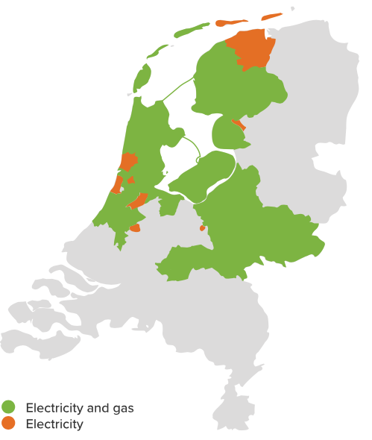
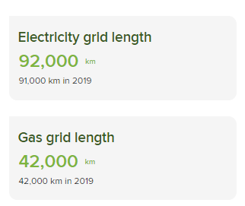

About Alliander and me
Dutch DSO
Ing Sander Jansen
Product Owner virtual substations
Background in
Data architecture
Electrical engineering
Notes:
Product owner
CoMPAS TSC member

Slide 4
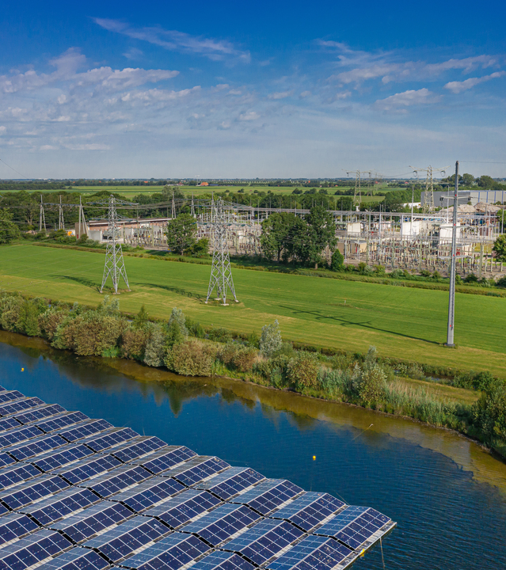
The challenge
61850 engineering process varies
Desktop oriented
Limited choice in IED vendor agnostic SCL tools
Not built for integration
Vendor lock-in (Tool vendor decides on development)
Variation in tool implementations
Limited flexibility (e.g., limited automation)
The problem with current IEC 61850 SCL tooling
Notes:
Non of the tools today can meet these needs

Slide 5
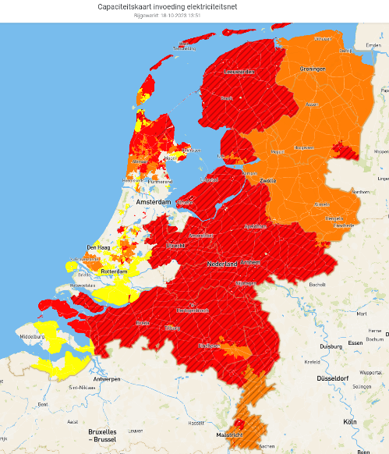
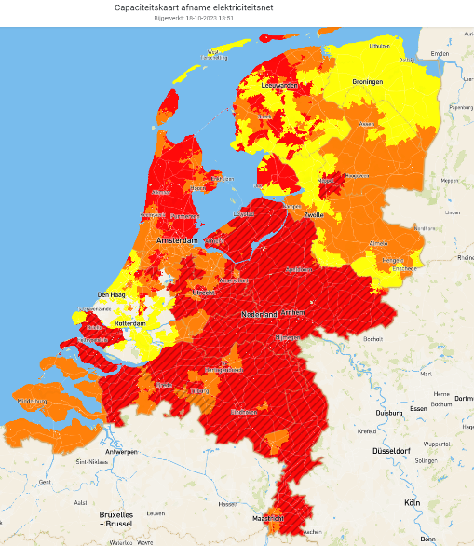
Change ahead
Why tools need to improve
Hard to find technical staff: Need for efficiency
More insights in configurations needed
Increasing importance of SCL tools to support multivendor / interchangeability
IEC 61850 used in DER
No manual XML editing anymore
Grid feed-in limitations
Grid consumption limitations
Capaciteitskaart elektriciteitsnet (netbeheernederland.nl)
Notes:
Hard to find technical staff: Need for efficiency
We have a hard time finding new staff to keep up with the speed needed for the energy transition: Efficiently/automation is needed!
More insights in configurations needed
The more congestion we have on the grid, the more we to measure and control system operations; prevent unintended behavior.
Substation of the future requires:​
Dynamic protection settings​
Adaptive automation functions​
Insights in measurement quality​
Great (configuration) data management​
administration​
deployment​
​
Increasing importance of SCL tools to support multivendor / interchangeability
Multi vendor strategy is needed to spread the risks and dependancies
Repeatable SCL (error free) workflow: Prevent open XML files manually

Slide 6
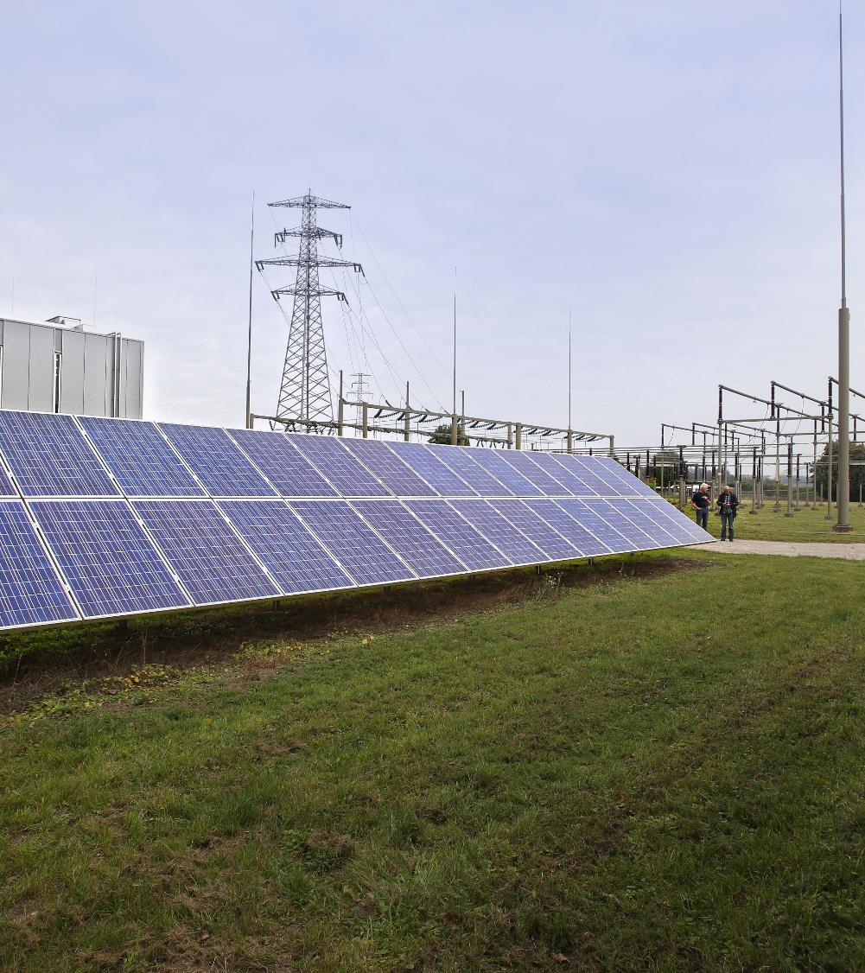

Solution
Open-source approach
Central SCL data management
Plug-in/flexible architecture
(private) cloud hosted
"Easy" to use
Introducing the open-source project : LF energy CoMPAS
Notes:
Open-source approach
Open source code freely available under and open source license
Drive your own roadmap
No vendor lock-in
Neutral project home: LF energy
Focus on security
Permissive license
Better off by sharing
Open Source : is simply defined as a permissive IP license that enables shared investment and leveraged development
Central SCL data management
Mange you SCL data in a single location
Plug-in/flexible architecture
Just enable the plug-ins you need;
Build utility/vendor specific plug-ins
(private) cloud hosted
CoMPAS is build with cloud native idea's in mind (e.g. micro services)
The cloud allow us to deploy fast (30 minutes)
(partly) outsourced hosting and managed database
Deployment: every 2 weeks
"Easy" to use
We try to make 61850 easy with a focused UI; the plugin architecture helps to keep focus.

Slide 7
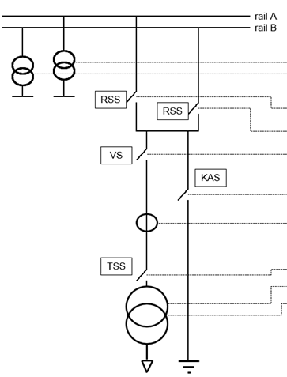



LF Energy substation architecture
From sensor to gateway
Merging unit / IO / Digital instrument transformer
IEC 61869-13
IEC 61869-9
Substation functions e.g protection
Gateway
Central systems
61850 processbus
61850 stationbus
61850 SCL
Notes:
Other projects into the LF energy eco system.

Slide 8
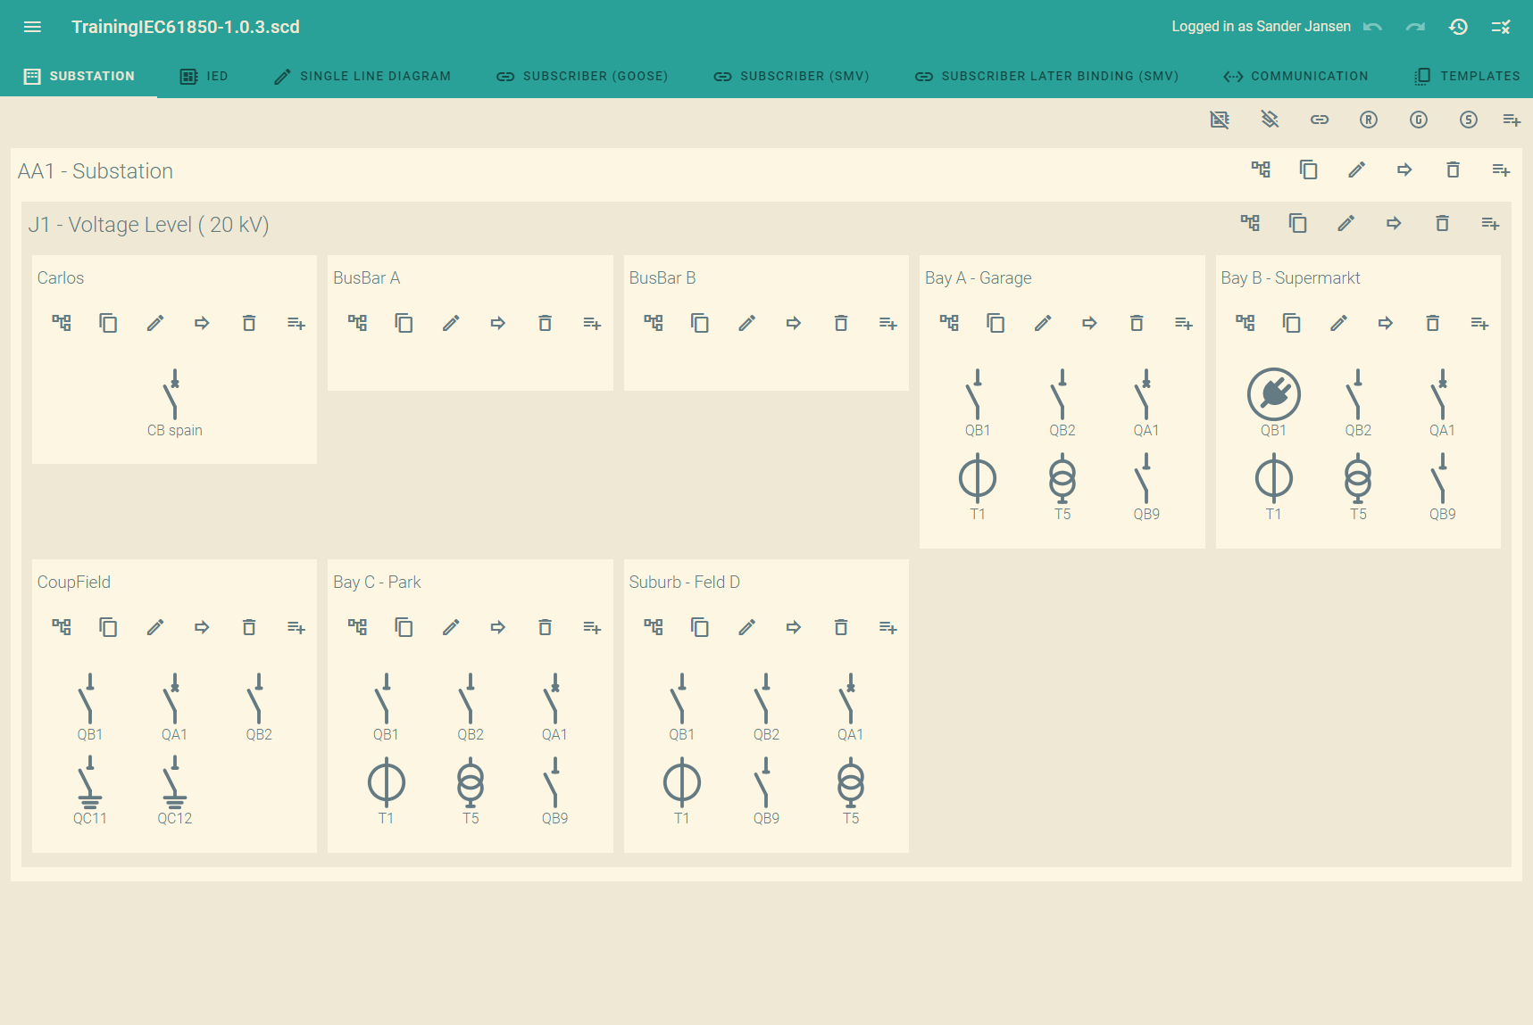
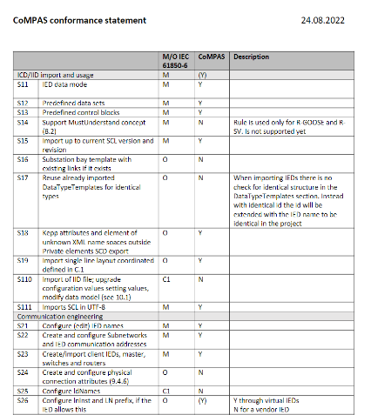
Current features
Current capabilities of LF energy CoMPAS
Basic SCL editing
GOOSE/SV
Reporting
104 support (80-1)
Compare IED's/SCL files
SCL cleanup
Library for SCD generation process
IEC CIM to IEC 61850 conversion
Services
Many more..
Notes:
Basic SCL editing
GOOSE/SV
Reporting
104 support (80-1)
Compare IED's/SCL files
SCL cleanup
Library for SCD generation process
IEC CIM to IEC61850 conversion
Other things include:
XSD validation
Riseclipse integration
Relevant parameter export
Role based access
Single sign on

Slide 9
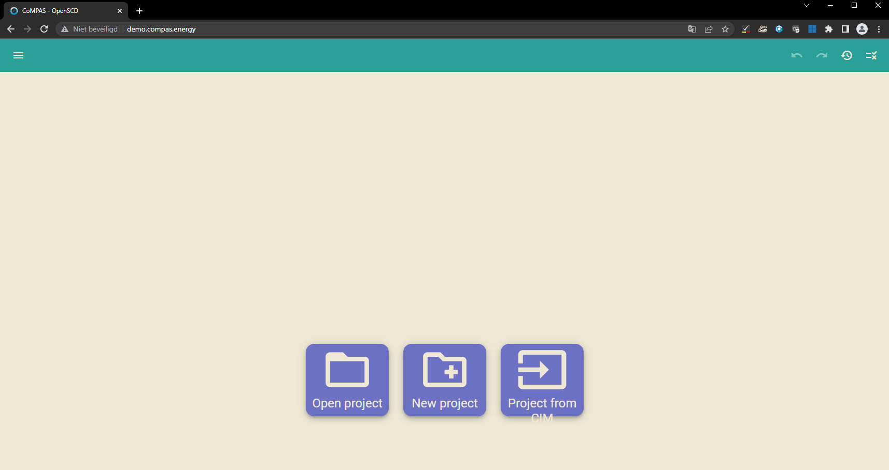
https://demo.compas.energy/
Notes:
We noticed that is somethings hard for engineers to evaluate/try new tools due to desktop security policies.
To try the software more easily, we setup a public test environment with a shared database.
That means: if you store stuff to the database, all users can see it.
Log-in is required to prevent abuse!

Slide 10
CoMPAS ecosystem roadmap
What is coming up?
SCD generation
Better plug-in architecture
Single line editor (Omicron Plug-in)
Idea's:
Modbus support
61850 gateway support (61850-90-2)
Easier SCL checking and correction
User rights
Substation logic
61850-90-30
Notes:
The LF energy CoMPAS project is under active development.
We plan activities per quarter
VMU example

Slide 11



Everybody is welcome to contribute!
Ways to contribute
Bug reports / Fixes
Documentation
Feature requests
Test with vendor tools
Build your own plug-in
Code contributions
Active contributing CoMPAS/OpenSCD:
Notes:
LF energy memberschip is not required
Vendors/Uitlities/consultants/Intergrators/invididuals
If you feel well to contribute directly, use a 3th party to help you (e.g. your development suppliers).

Slide 12
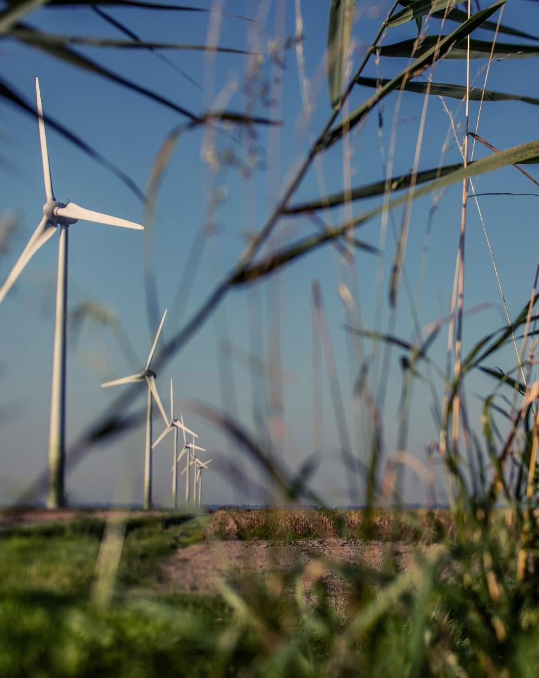






Where to start?
Wiki: LF Energy wiki
LF energy slack: #compas
Github.com/com-pas
Github.com/OpenSCD (upstream project)
lists.lfenergy.org CoMPAS
Youtube tutorials
URL’s and communicaiton
Notes:
Recap:
Change is needed
Configurations are increasing importance
Key defferenciator: centralized and fully open source Join our
Check out other LF energy projects

Slide 13
Thanks for your attention!
Sander.jansen@alliander.com

